Slide 1

FMV – Beyond the Surveys
HMS Valuation Partners
February 25, 2024
CAPTURING HEALTHCARE VALUE WITH CLARITY

Slide 2







Physician Compensation Valuation & Plan Design
Value-Based Compensation
Hospital Coverage & ER Call Services
Telemedicine
Management Services Valuations
Practice Acquisitions
Fixed Asset Valuations
Real Estate Valuations
Medical Office Timeshares
25+
YEARS
1996 - 2024
CAPTURING HEALTHCARE VALUE WITH CLARITY

Slide 3

Introductions
30 Years of Healthcare Valuation Experience
His primary focus is on overseeing:
  Physician/ Hospital Transactions
  Fair Market Value /
  Commercial Reasonableness
  Provider Compensation Design
  APP Compliance
Clinical Experience – 20 years
Family / Women’s Health Nurse Practitioner
Joe Aguilar, MBA, MPH, MSN, CVA
Partner, HMS Valuation Partners
CAPTURING HEALTHCARE VALUE WITH CLARITY

Slide 4



Introductions
20 Years of Healthcare Valuation Experience
His primary focus is on overseeing:
  Physician/ Hospital Transactions
  Fair Market Value /
  Commercial Reasonableness
  Provider Compensation Design
  Value-Based Arrangements
30+ Years as a lawyer and avid national speaker on topics including Stark, AKS, and FMV/CR
Chip Hutzler, JD, MBA, CVA
Partner, HMS Valuation Partners
CAPTURING HEALTHCARE VALUE WITH CLARITY

Slide 5
2021 - New Fair Market Value Definition
  Elements:
    Fair Market Value means… the value in an arm’s-length transaction, consistent with the general market value of the subject transaction (similar statements for rental of space or equipment)
    General Market Value means… the compensation that would be paid at the time the parties enter into the service arrangement as the result of bona fide bargaining between well-informed parties that are not otherwise in a position to generate business for each other. (similar statements for purchase of assets, rental of equipment or office space)
  What’s Not in the New Definition?
    Removal of language involving volume or value of referrals from FMV definition, but CMS commentary reiterates concern about consideration of comparables involving parties in a position to refer to each other.
    CMS included pages of commentary on the use of salary survey data, suggesting that while survey data is an “appropriate starting point,” ultimately, FMV is dependent on the facts and circumstances and deviation (either higher or lower) from survey data may be appropriate or necessary depending on the circumstances.
CAPTURING HEALTHCARE VALUE WITH CLARITY

Slide 6
CMS Key Commentary on FMV
  FMV is “buyer” neutral – i.e., should not consider value to the DHS entity of doing the deal.
  No Rebuttable Presumption – despite urging of commentors.
    Burden on parties to prove compensation was FMV
  Comparables between parties in a position to refer
    Use of “tainted” data still discouraged, if no longer outright banned
  CMS has concerns about how survey data is utilized by parties
    No “rules of thumb” or bright-line survey percentiles that dictate FMV
    Surveys are just a starting point – benchmarking alone is not sufficient.
    Must consider all the facts and circumstances to determine FMV
CAPTURING HEALTHCARE VALUE WITH CLARITY

Slide 7
CMS Commentary on Survey Data
  How to account for the new Stark commentary on survey data.
    Surveys are just a starting point – benchmarking alone is not sufficient.
    Must consider all the other factors that impact FMV
      What are those factors?
        Physician-specific factors (experience, training, skills, etc.)
        Location-specific factors (size, competition, payor mix, etc.)
        National market factors (staffing shortages, inflation, etc.)
        Task-specific factors (specialty, acuity, volume, hours, coverage)
        Situational factors (background facts, problems to be solved, etc.)
    Consistency and documentation will be key to defensibility
      Evaluation of a high-volume of transactions simply and defensibly will be the new challenge
CAPTURING HEALTHCARE VALUE WITH CLARITY

Slide 8
CMS Examples in Commentary
  Orthopedic Rockstar:
    “By way of example, assume a hospital is engaged in negotiations to employ an orthopedic surgeon. Independent salary surveys indicate that compensation of $450,000 per year would be appropriate for an orthopedic surgeon in the geographic location of the hospital. However, the orthopedic surgeon with whom the hospital is negotiating is one of the top orthopedic surgeons in the entire country and is highly sought after by professional athletes with knee injuries due to his specialized techniques and success rate. Thus, although the employee compensation of a hypothetical orthopedic surgeon may be $450,000 per year, this particular physician commands a significantly higher salary. In this example, compensation substantially above $450,000 per year may be fair market value.” 85 FR 77554 (December 2, 2020)
  Family Practitioner in Rural Area:
    “On the other hand, hypothetical data may result in hospitals and other entities paying more than they believe appropriate for physician services. Assume a hospital is engaged in negotiations to employ a family physician. Independent salary surveys indicate that compensation of $250,000 per year would be appropriate for a family physician nationally; no local salary surveys are available. However, the cost of living in the geographic location of the hospital is very low despite its proximity to good schools and desirable recreation opportunities, and, due to declining reimbursement rates and a somewhat poor payor mix, the hospital’s economic position is tenuous. Although the physician may request the $250,000 that the salary survey indicates would be appropriate for a hypothetical (unidentified) physician to earn, and the hospital may believe that it is compelled to pay the physician this amount, the fair market value of the physician’s compensation may be less than $250,000 per year (84 FR 55799).” 85 FR 77554 (December 2, 2020)
  Cardiothoracic surgeon:
    “For example, in an area that has two interventional cardiologists but no cardiothoracic surgeon who could perform surgery in the event of an emergency during a catheterization, a hospital may need to pay above the amount indicated at a particular percentile in a salary schedule to attract and employ a cardiothoracic surgeon.” 85 FR 77557 (December 2, 2020)
CAPTURING HEALTHCARE VALUE WITH CLARITY

Slide 9
Employment / PSA Agreements
Surveys serve as an excellent starting point, however, you may be missing value if you end there.
CAPTURING HEALTHCARE VALUE WITH CLARITY

Slide 10
Dr. Ashley Jones - Rockstar
  “By way of example, assume a hospital is engaged in negotiations to employ an orthopedic surgeon [Dr. Ashley Jones]. Independent salary surveys indicate that compensation of $450,000 per year would be appropriate for an orthopedic surgeon in the geographic location of the hospital. However, the orthopedic surgeon with whom the hospital is negotiating is one of the top orthopedic surgeons in the entire country and is highly sought after by professional athletes with knee injuries due to his specialized techniques and success rate. Thus, although the employee compensation of a hypothetical orthopedic surgeon may be $450,000 per year, this particular physician commands a significantly higher salary. In this example, compensation substantially above $450,000 per year may be fair market value.” 85 FR 77554 (December 2, 2020)
CAPTURING HEALTHCARE VALUE WITH CLARITY

Slide 11
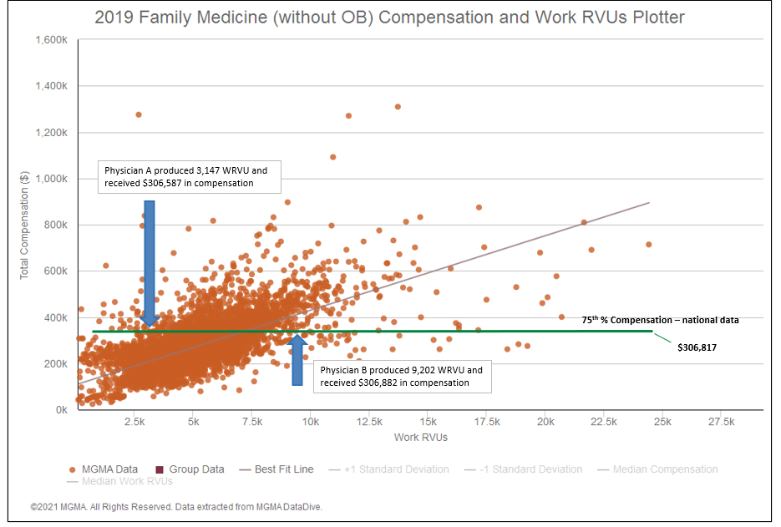
Compensation should be Specific to the facts
CAPTURING HEALTHCARE VALUE WITH CLARITY

Slide 12
Survey Data Challenge - wRVUs
Are Compensation and Production correlated?
  MGMA Warning on Behavior of Conversion Rates:
(source: 2013 MGMA Physician Compensation and Production Report, mgma.com/data – total cash compensation and Work RVUs)
CAPTURING HEALTHCARE VALUE WITH CLARITY

Slide 13
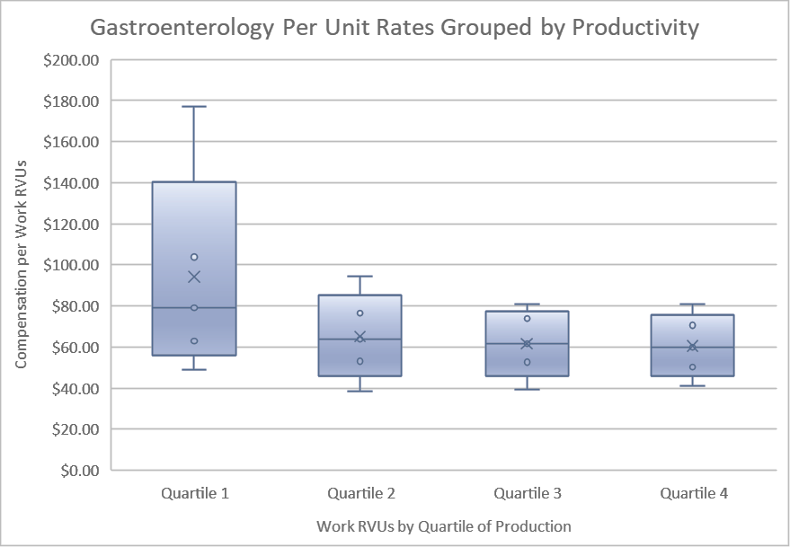
Survey Data Challenge - wRVUs
Behavior of Per-Unit Conversion Rates
  MGMA Data within each quartile:
(source: 2017 MGMA DataDive Provider Compensation, mgma.com/data – total cash compensation by quartile of production)
CAPTURING HEALTHCARE VALUE WITH CLARITY

Slide 14
ER Call Coverage Agreements
Understanding that ER Call value is Facility-Specific
CAPTURING HEALTHCARE VALUE WITH CLARITY

Slide 15
GI Call Coverage
  You just got word that your GI call panel are refusing to take call unless the rate goes from $850 to $2,500 per day. They tell you that they would rather stay in their endosuites doing endoscopies then travel to the hospital for challenging patients with limited payor resources.
CAPTURING HEALTHCARE VALUE WITH CLARITY

Slide 16

Taking Call Rates Apart & Putting them Back Together
Are not all call rates the same for the specialty in a market?
Are there factors unique to the facility, call requirements, compensation terms that impact the rate?
Is the call rate the same for community physicians as it is for an employed physician?
CAPTURING HEALTHCARE VALUE WITH CLARITY

Slide 17
Components of Call Value
Availability
  May be the lion-share of the value
  Value associated the physician’s commitment to the facility
Acuity level
  Trauma designation
  Complexity of cases received
Burden Volume
  # of phone calls, hallway consults, and/or in-person assessments
  Could consider # of shifts per month
Payor Mix Impact
  Poor Payor Mix = Higher Value
  Only affects at-risk rates; not appropriate for employed providers under a wRVU term
CAPTURING HEALTHCARE VALUE WITH CLARITY

Slide 18
Hospital-Based Services Agreements
A function of revenues, staffing, provider compensation, and other key factors
CAPTURING HEALTHCARE VALUE WITH CLARITY

Slide 19
OB Laborist Program
  Your hospital has a laborist program that covers unassigned OB patients needing care. You have a robust number of community OB physicians as well as two OB groups employed by your system. The laborist contract is coming up for renewal. You are considering some of the following:
  Staffing the service (MD vs. CNMs)
  Impact from Obstetrical Services Agreements
  FMV considerations for the Employed Physicians when they receive credit under the global delivery code but don’t actually deliver
  The value of providing a delivery service for the community physicians.
CAPTURING HEALTHCARE VALUE WITH CLARITY

Slide 20
OB Laborist Program
Key Value Drivers – Simple math with complex inputs
Income Statement – Hospital-Based Service
 | Hospital A | Comment
Total Revenues | $800,000 | Include all sources
Provider Compensation | $1,600,000 | Consider workload/coverage to determine FMV
Operating Expenses | $220,000 | Review Agreement Terms to determine FMV
Total Program Expenses | $1,820,000 | Effective Collections Guarantee
Profit / (Loss) | ($1,020,000) | Effective Subsidy
CAPTURING HEALTHCARE VALUE WITH CLARITY

Slide 21
OB Laborist Program
  Revenue Guarantee vs. Stipend
  Staffing the Service
    FTE vs Hours Staffed
    Restricted vs Un-restricted
    Staff Mix: MD vs APP
  Determining Provider Compensation
    Number of hours covered and how
    Number of patients / cases / wRVUs
    GME services provided in addition to clinical coverage
  Other Terms and/or Considerations
    OSA Revenue from Community Physicians or Health System Employed Physicians
    Payor of Last Resort options for providing indigent care
CAPTURING HEALTHCARE VALUE WITH CLARITY

Slide 22
Value-Based Arrangements
When is FMV needed, and if so, how to determine FMV of quality metrics…
CAPTURING HEALTHCARE VALUE WITH CLARITY

Slide 23
Value-Based Arrangements
  Healthcare Entity wants to form a network of providers to improve quality, efficiency and achieve cost savings.
  Various metrics are identified to measure the success of the venture and to determine the payment to the parties for achievements made.
  Physicians don’t want to take any downside risk
CAPTURING HEALTHCARE VALUE WITH CLARITY

Slide 24
Value-Based Arrangements
  When is FMV needed in Value-Based Arrangement?
    FMV not needed IF:
      Stark – FMV not required to fit into one of the 3 new Stark VB exceptions – 42 CFR 411.357(aa)(1) to (3)
        But beware of other requirements: CR, monitoring, and V/V-like requirements.
      AKS – FMV not required to fit into the 2 risk-based VB safe harbors – 42 CFR 1001.952(ff) and (gg)
    FMV still needed IF:
      AKS – Outcome-based payments framework of the Personal Services Safe Harbor – 42 CFR 1001.952(d)
      AKS - Care Coordination Safe Harbor - requires contribution (at cost or FMV) – 42 CFR 1001.952(ee)
      IRS Private Benefit/Private Inurement rules
      State Law? (it depends)
  If FMV is still needed, how is it determined?
CAPTURING HEALTHCARE VALUE WITH CLARITY

Slide 25

CAPTURING HEALTHCARE VALUE WITH CLARITY

